Slide 1
Revising Institutional strategies in the context
of the 2030 Agenda
Integrating SDGs into university policy:
the experience at the URV
John Style
vr.internacional@urv.cat
IHES, DEC 2021

Slide 2
The University Rovira i Virgili (URV) aligned their strategic plan and activities with the 17 Sustainable Development Goals of the Agenda 2030, with the mission of disseminating them among the university community and other stakeholders
This is how we do it
Management action
2018-2002 Action Plan
Annual report of the rector to the Senate
Accountability
Global Vision
Training and dissemination
Activities / Conferences / Seminars

Slide 3
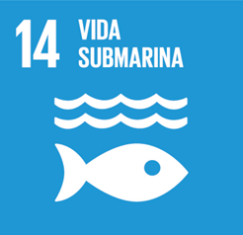
Strategic Plan: 2018 – 2022 Action Plan
Number of
objectives / actions
Sustainable Development Goals
Strategic lines
1. Teaching
2 / 19
2. Research and Transfer
7 / 21
3. Persons
8 / 42
4. Internationalisation
3 / 12
5. Social Commitment
2 / 6
6. Governance
2 / 10
7. Students and Employability
6 / 33

Slide 4
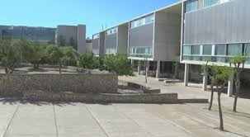
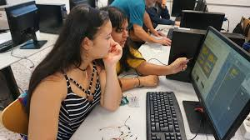
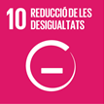
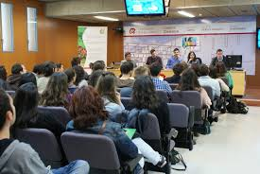
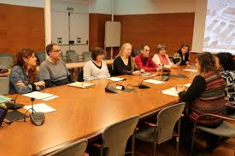
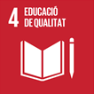
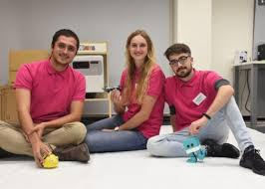
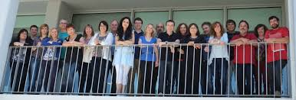
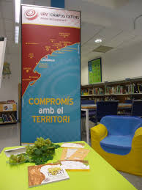
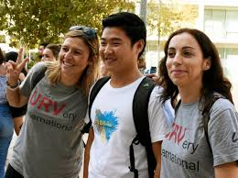
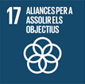
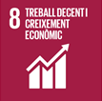
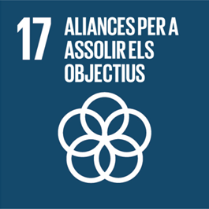
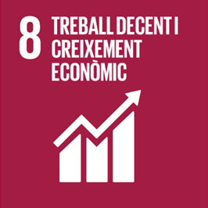
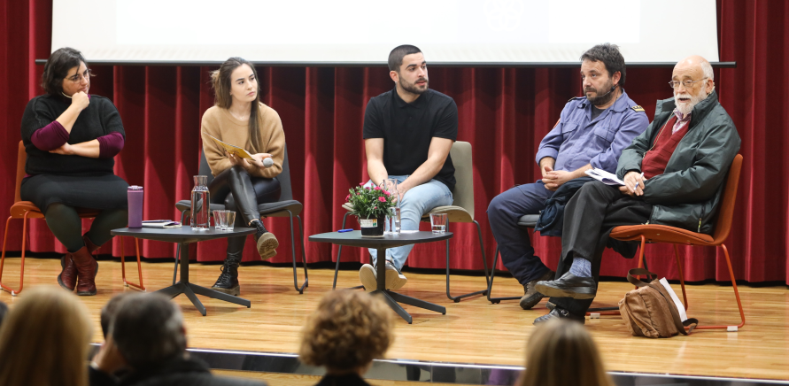
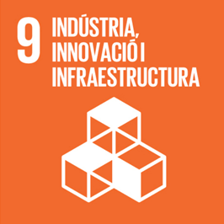
2018 – 2022 Action Plan – Examples of Actions
Enhancing transversal training
Increasing online training
Increasing resources
for research
Promoting ethic behaviour
Encouraging teamwork
Stabilizing the temporary staff
Internationalization
Engagement
with the territory
Promoting
Employability
Stimulating critical and innovative thinking
Promoting Lifelong Learning

Slide 5
Accountability: Annual report of the Rector to the Senate: actions 2020-21
Strategic lines
Actions
1. Teaching
12
2. Research and Transfer
18
3. People
20
106
4. Internationalisation
7
5. Social Commitment
11
6. Governance
23
7. Students and Employability
15

Slide 6
Annual report of the Rector to the Senate: actions 2020-21
Enhancing transversal training
Increasing online training
Increasing resources
for research
Promoting ethic behaviour
New double degree
programs
6 masters online
and 15 blended
50 new PhD
scholarships
per year
Integrating
the Ethical
Code
Encouraging SDG
understanding
Stabilizing the temporary staff
Engagement with the territory
Internationalization
68 positions of PAS
for stabilisation
Rural
coworking
Third language
promotion plan
Minor in Social
Entrepreneurship &
SDGs
Promoting
Employability
Stimulating critical and innovative thinking
Promoting Lifelong Learning
Master of Development Cooperation and Social
Transformation
“Tools for Social
entrepreneurship”
Creation of
the Social
Commitment Office / IHES

Slide 7
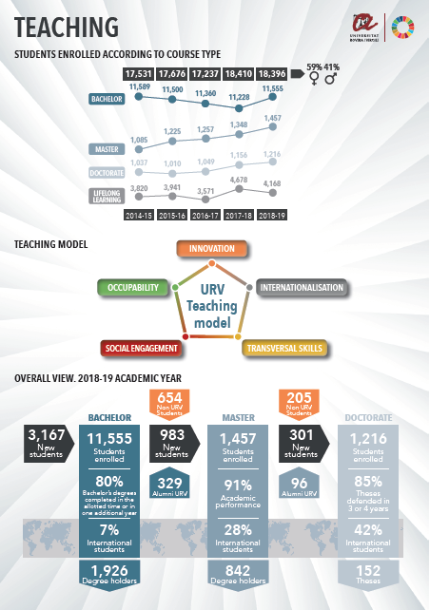
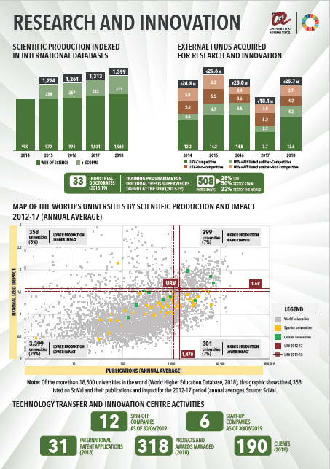
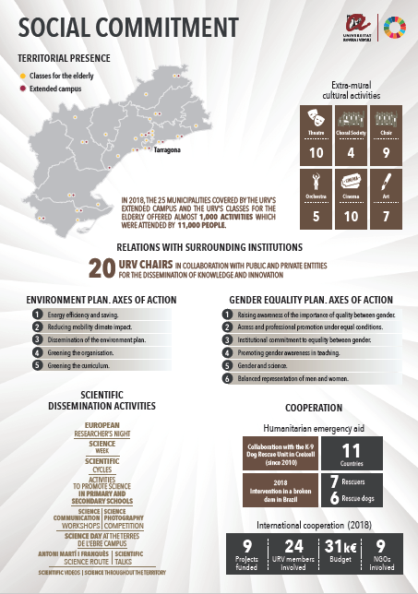
Global Vision

Slide 8
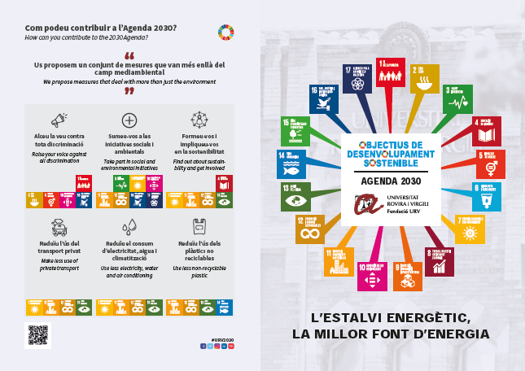
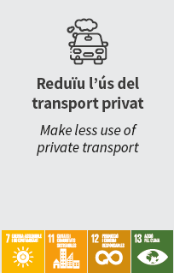
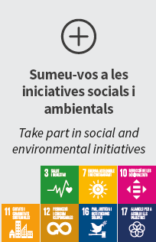
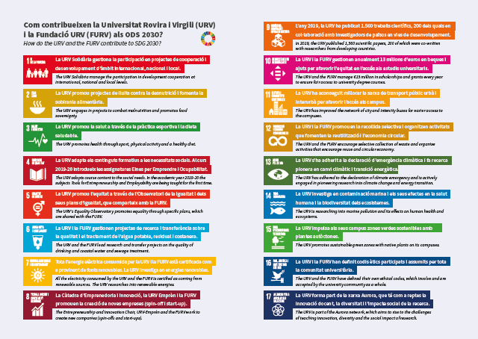
Dissemination

Slide 9
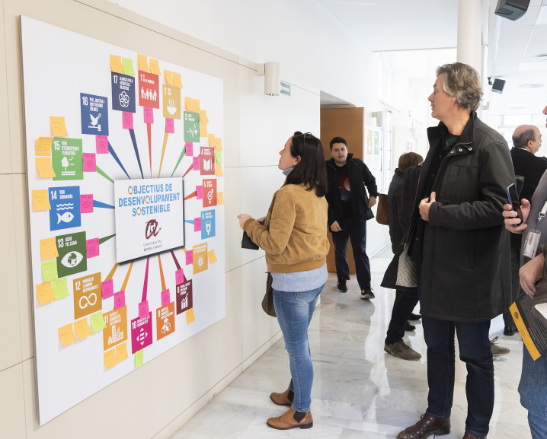
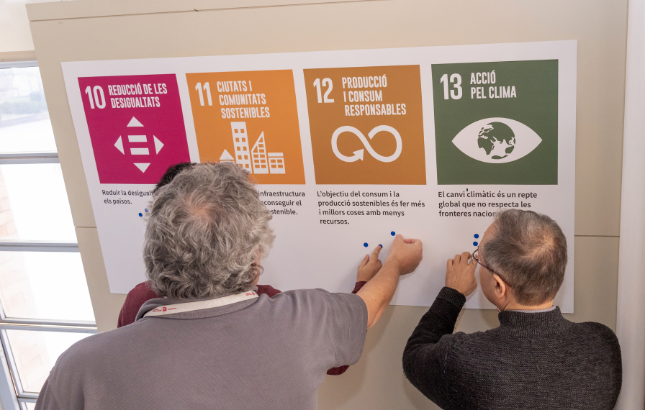
Brainstorming at the coffee break of the Senate session
Dissemination
In which SDG’s do you think the URV should focus its activity?
In which SDG’s would you want to participate?
Do you have ideas of how URV should be working for achiving SDG´s?
How do you
get involved?

Slide 10
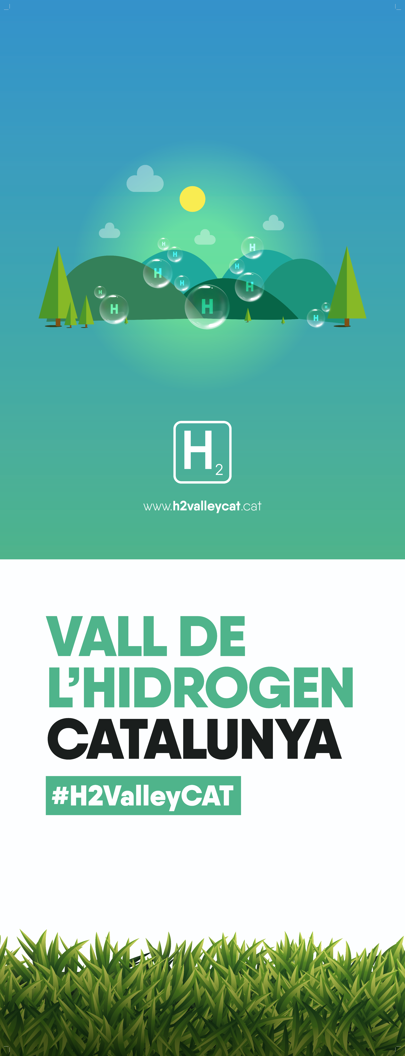
URV’s leadership in major local economic regeneration plans
Actions
2020-21
2. Research i & Transference
Maintaining support for leading areas and supporting emergint areas.
2.1
October 2020 – May 2021
2.1.5 Hydrogen Valley of Catalonia (H2ValleyCAT)
Led by the URV: some 27 projects included in Next Generation Catalonia for economic recovery, opting for EU Next Generation funds. More than 130 públic and private entitites, and 30 projects in areas of industrial chemistry, mobility, circular economy and infrastructure for hydrogen, R+D+i and training.
Project presented on 14 May 2021 at the Palau de Fires i Congressos de Tarragona, in an event presided over by the Rectora of the URV and the vicepresident of the Generalitat de Catalunya.
Signatories of the agreement: URV, Deparment for Business and Knowledge, Provincial government of Tarragona, Port Authority of Tarragona, AEQT, Metropolitan Area of Barcelona, two major energy companyies, Enagas and Repsol.
Scientific-technological Memorandum: Signatories: URV, Eurecat, IREC, ICIQ.

Slide 11
URV as member of the Aurora universities - Aurora SDG Research Dashboard

Slide 12
Screen shot of the Aurora SDG Research Dashboard – completely searchable!

Slide 13
www.urv.cat

