Slide 1
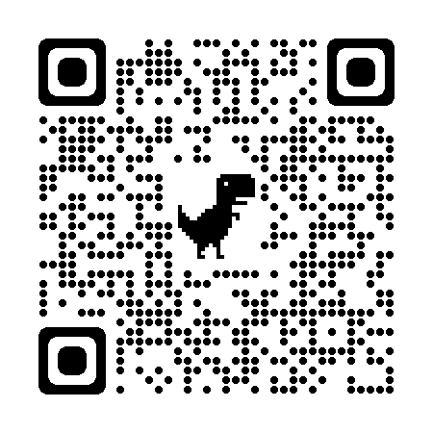
Learning , teaching and enjoying an international experience at our regional schools
Our motivation: Sharing the university international background with our region helping young local students to open their minds and improve their communication skills.
Our biggest challenge: Encourage and involve the main actors; university international students and schools with scarce financial resources in a post COVID-19 context.
Our Key Enabler: Receiving support from all the governing bodies, i.e. the university and the Catalan Education Department, as well as international mobility programs.
Student Mobility in Learning English (SMiLE)

Slide 2
Recommendations
(1) Fluid communication amongst the different stakeholders is a must.
(2) Don’t give up! It takes time to see the benefits of this program and it requires a lot of coordination work but it’s worth the effort.

