Slide 1
Sustainable Living Through Indigenous Practices

Slide 2
The Centre for Social Impact and Research
Thematic Groups
Academics Scientists Engineers Lawyers
Students Corporates
Government
Multidisciplinary research and education centre
Teaching, Training, Research and Advocacy
To facilitate, strategize and nurture; feasible and sustainable activities
To devise pragmatic approaches to challenges
Overview
Located in suburbs of a metro city in rural India engages with the society to offer research-based holistic and sustainable solutions to some of the persisting environmental and societal issues by identifying areas of immediate attention and implement feasible solutions
The project encourages and empowers communities to attain “sustainable living” through indigenous practices backed by modern technologies as needed, encompassing the areas of education, health, water etc.

Slide 3
Research Expectations
CHALLENGE-DRIVEN
INTERDISCIPLINARY
ALLIANCE
IMPACT
Involves students in experiential learning and research activities on issues concerning health, education and water
Business, engineering, and law faculty and students conduct effective research on various issues of economically weaker sections of society
Applying technologies and expertise developed at Alliance to solve human-centric problems.
Aim for real projects that are innovative and that benefit environment and the society at large raising the standard of living of the poor
Identify of current research and development needs | Design solution-focused action research
Research funding from public and private institutions | Conduct training courses, conferences, and seminars
Collaborate with research agencies, universities and practitioners in India and abroad | Conduct baseline, need assessment and social impact assessment surveys

Slide 4
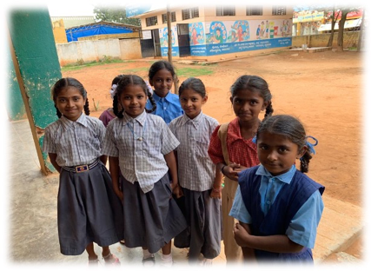
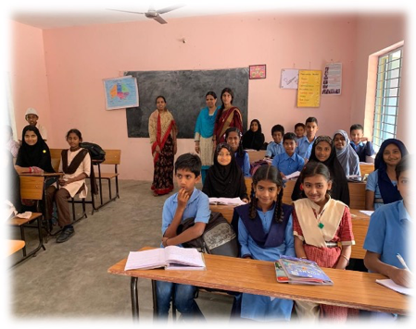
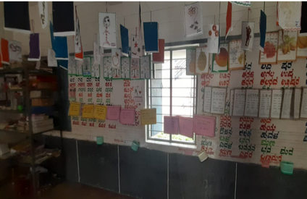
Sustainable Living Through Indigenous Practices
Intersection of academic/professional engagement
Engagement
Research
Innovation
Impact
Protection of livelihood & regulation of street vending
Implementation of Right to Education
Making a difference and having impact
Continuous improvement
Other research projects in Thrust Areas

Slide 5
Enablers & Challenges
Enablers (inside and outside the institution) | Issues (Obstacles and problems faced)
Inclusive Employment practices: Hiring local workers wherever possible | Level of education of local community
Outreach Programme: Adoption of five nearby villages | Multiple ethnic groups in the local community
Bridging the gap between the University and the local community | Language barriers – particularly communicating legal aspects in local languages
Changes in occupational patterns due to the Covid-19 pandemic: Reverse migration Restrictions on businesses | Social barriers – limited access to women
Legal Awareness: Women’s rights Vendors’ rights | Frequent lockdown restrictions – closure of “non-essentials” and curtailing of movement
Active and enthusiastic participation of local women and youth | Political dimensions/interference

Slide 6
Project Flow
Technology-enabled connect with the local community
Usage of local cultural media to construct the message
Involvement of local youth in developing content and propagating message to local community
Sustained Involvement of local community in tackling local social issues
Local Issues
Livelihood
Local handicrafts
Small businesses
Child nutrition/health
Gender rights
Right to Education
The project provides a sustainable methodology for empowering local communities
Connecting with the local community via digital platforms to overcome the lockdown restrictions and to understand local issues.
Developing content using local cultural media, such as street plays.
Collaborating with local women and youth to develop greater awareness of issues and propagate this awareness to others in the local community, e.g. using social media.
The local community can extend this process to tackle other local social issues - sustainability

Slide 7
Thank You
Dr. Anubha Singh
Dr. Vivekanand
Prof. Mihir Dash

