Slide 1
Under the microscope: regional IHES laboratories
Josepa Garreta-Girona, 9 December 2021
IHES Virtual Conference 2021
Showcasing examples of good practice around the world Internationalisation in Higher Education for Society (IHES)

Slide 2
The project:

Slide 3
IHES PROJECT PARTNERS

Slide 4
IHES PROJECT INTELLECTUAL OUTPUTS
IO2) Report on current good practices in IHES across Europe - ACA
IO3) Report on the concept, implementation and results of the regional IHES laboratories in Catalonia and Olomoucky Region - URV
IO4) Guidelines for implementing IHES - GII
IO5) Developing a regional model for implementing internationalisation in higher education for society - SGroup
IO6) Establishing an IHES network of organisations - UPOL

Slide 5
IHES PROJECT INTELLECTUAL OUTPUTS
IO2) Report on current good practices in IHES across Europe - ACA
IO3) Report on the concept, implementation and results of the regional IHES laboratories in Catalonia and Olomoucky Region - URV
IO4) Guidelines for implementing IHES - GII
IO5) Developing a regional model for implementing internationalisation in higher education for society - SGroup
IO6) Establishing an IHES network of organisations - UPOL

Slide 6
IO3: Report on the concept, implementation and results of the regional IHES laboratories in Catalonia and Olomoucky Region

Slide 7
APPLIED METHODOLOGY
Establish the Catalonia IHES Lab and the Olomouc IHES Lab
Develop surveys and models to pilot
Organise Introduction to IHE sessions and conduct associated surveys
Prepare and undertake activities through the selected IHES activities and conduct associated surveys. Participants produce testimonial videos from activities.
Organise Open Seminars in Catalonia /Olomouc and conduct associated surveys
Production of a report based on the above-mentioned tasks, including a comparison of the results of the two Labs.

Slide 8
A/ SURVEYS DEVELOPEMENT
To measure the perception, learning outcomes and change in intercultural awareness of all the involved stakeholders.
The surveys will be conducted on-line before and after the following activities:
Introduction to IHES sessions in Catalonia and Olomouc IHES Labs.
Target group: university staff from the two institutions.
IHES activities implemented.
Target group: General population.
Multiplier events - Open Seminars in Catalonia and Czechia.
Target group: other universities in the regions.

Slide 9
A/ SURVEYS DEVELOPEMENT
Through my participation in this activity, I have become more aware that I am part of a globalised world.
This activity has opened my mind to other realities.
Because of this activity, I feel much more comfortable with the idea of traveling or even having experiences in other countries.
The activity has given me more confidence to relate with people from other cultures.
I like the thought that somewhere in this world other people may be participating in an activity like this.
Scale: strongly disagree 1 to strongly agree 10

Slide 10
B/ INTRODUCTION to IHES = TRAINING
Develop content & methodology
Design training materials
Training to take place
Dynamic, participatory and following the experience already gained through the SUCTI Erasmus+ Strategic Partnership project, specialised in training staff on internationalisation.

Slide 11
B1/ TRAINING CONTENTS
What is IHES?
What is internationalisation?
What are the global trends in Higher Education Internationalisation (IHE)?
Examples and good practices of IHES
Intercultural communication
What is in it for me?
Evaluation tool of activities
Participants’ projects for the Catalunya Lab

Slide 12
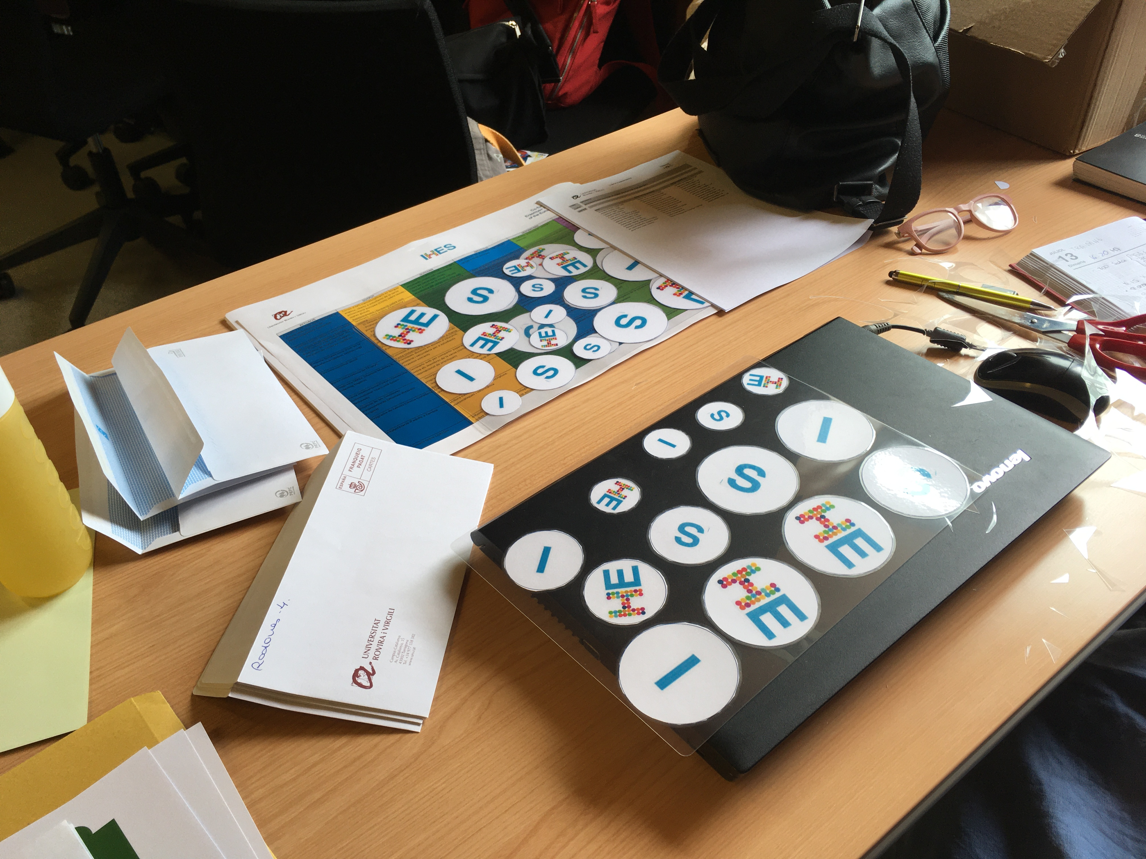
B2/ TRAINING MATERIALS

Slide 13
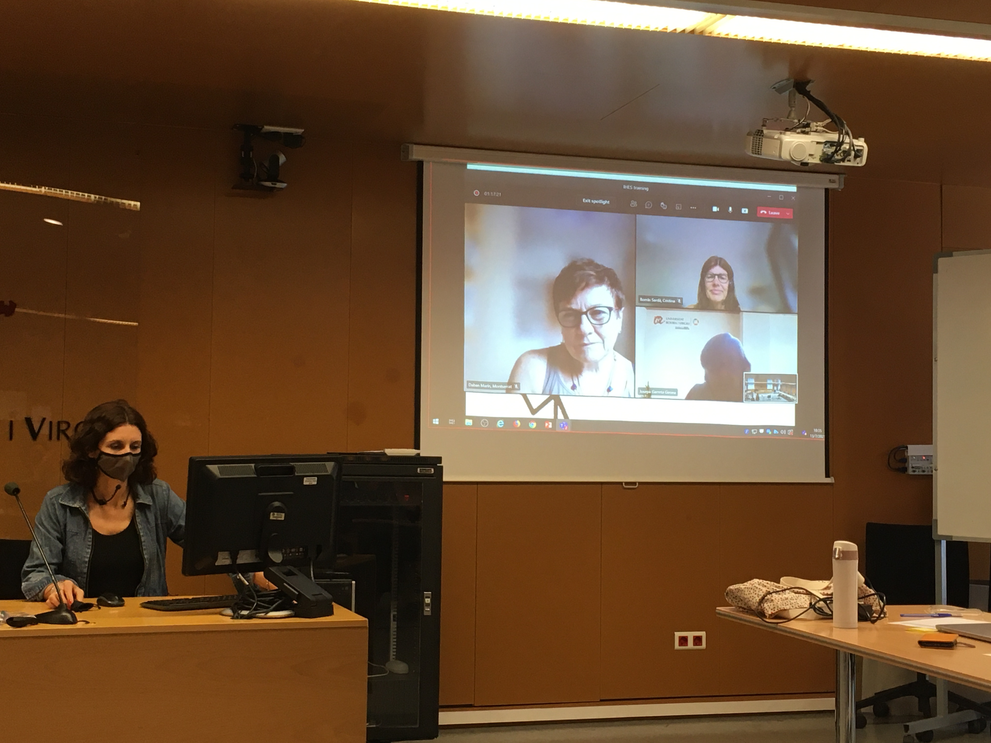
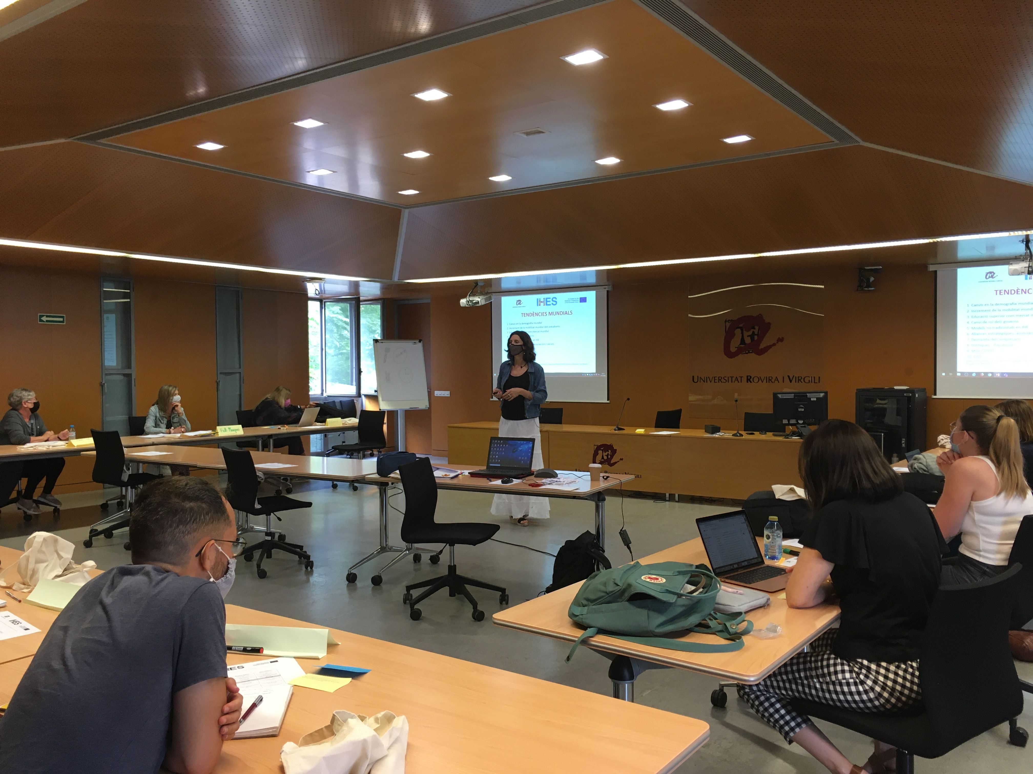
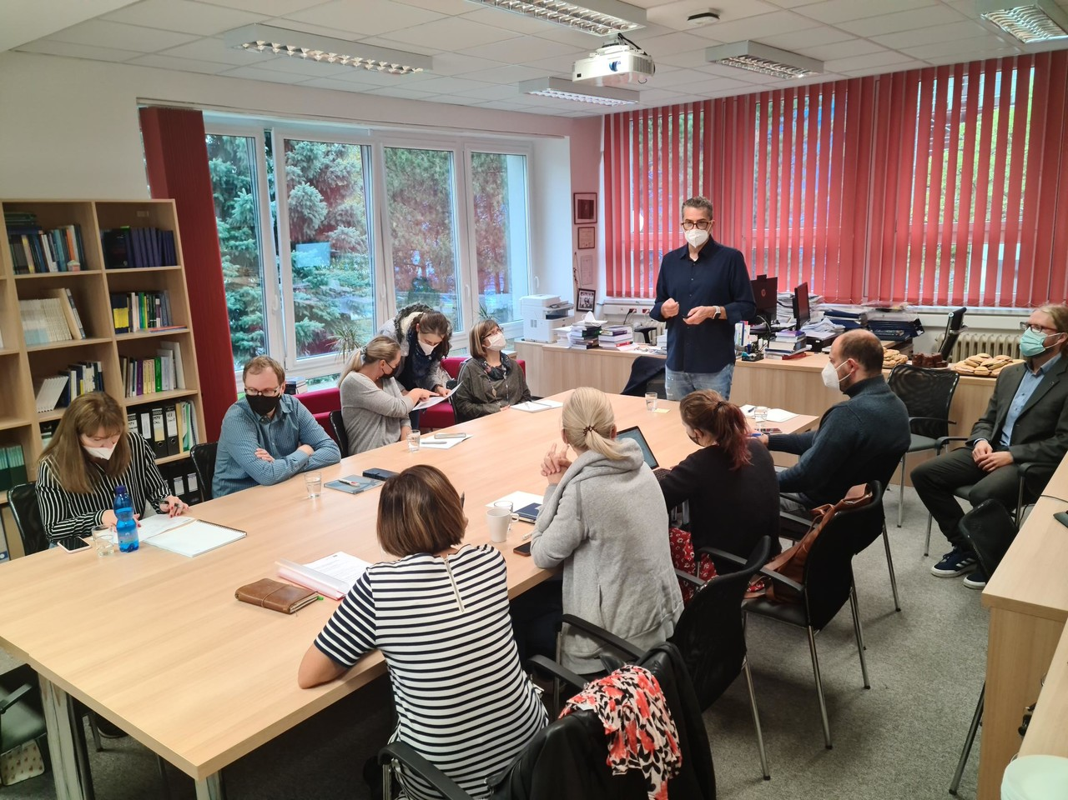
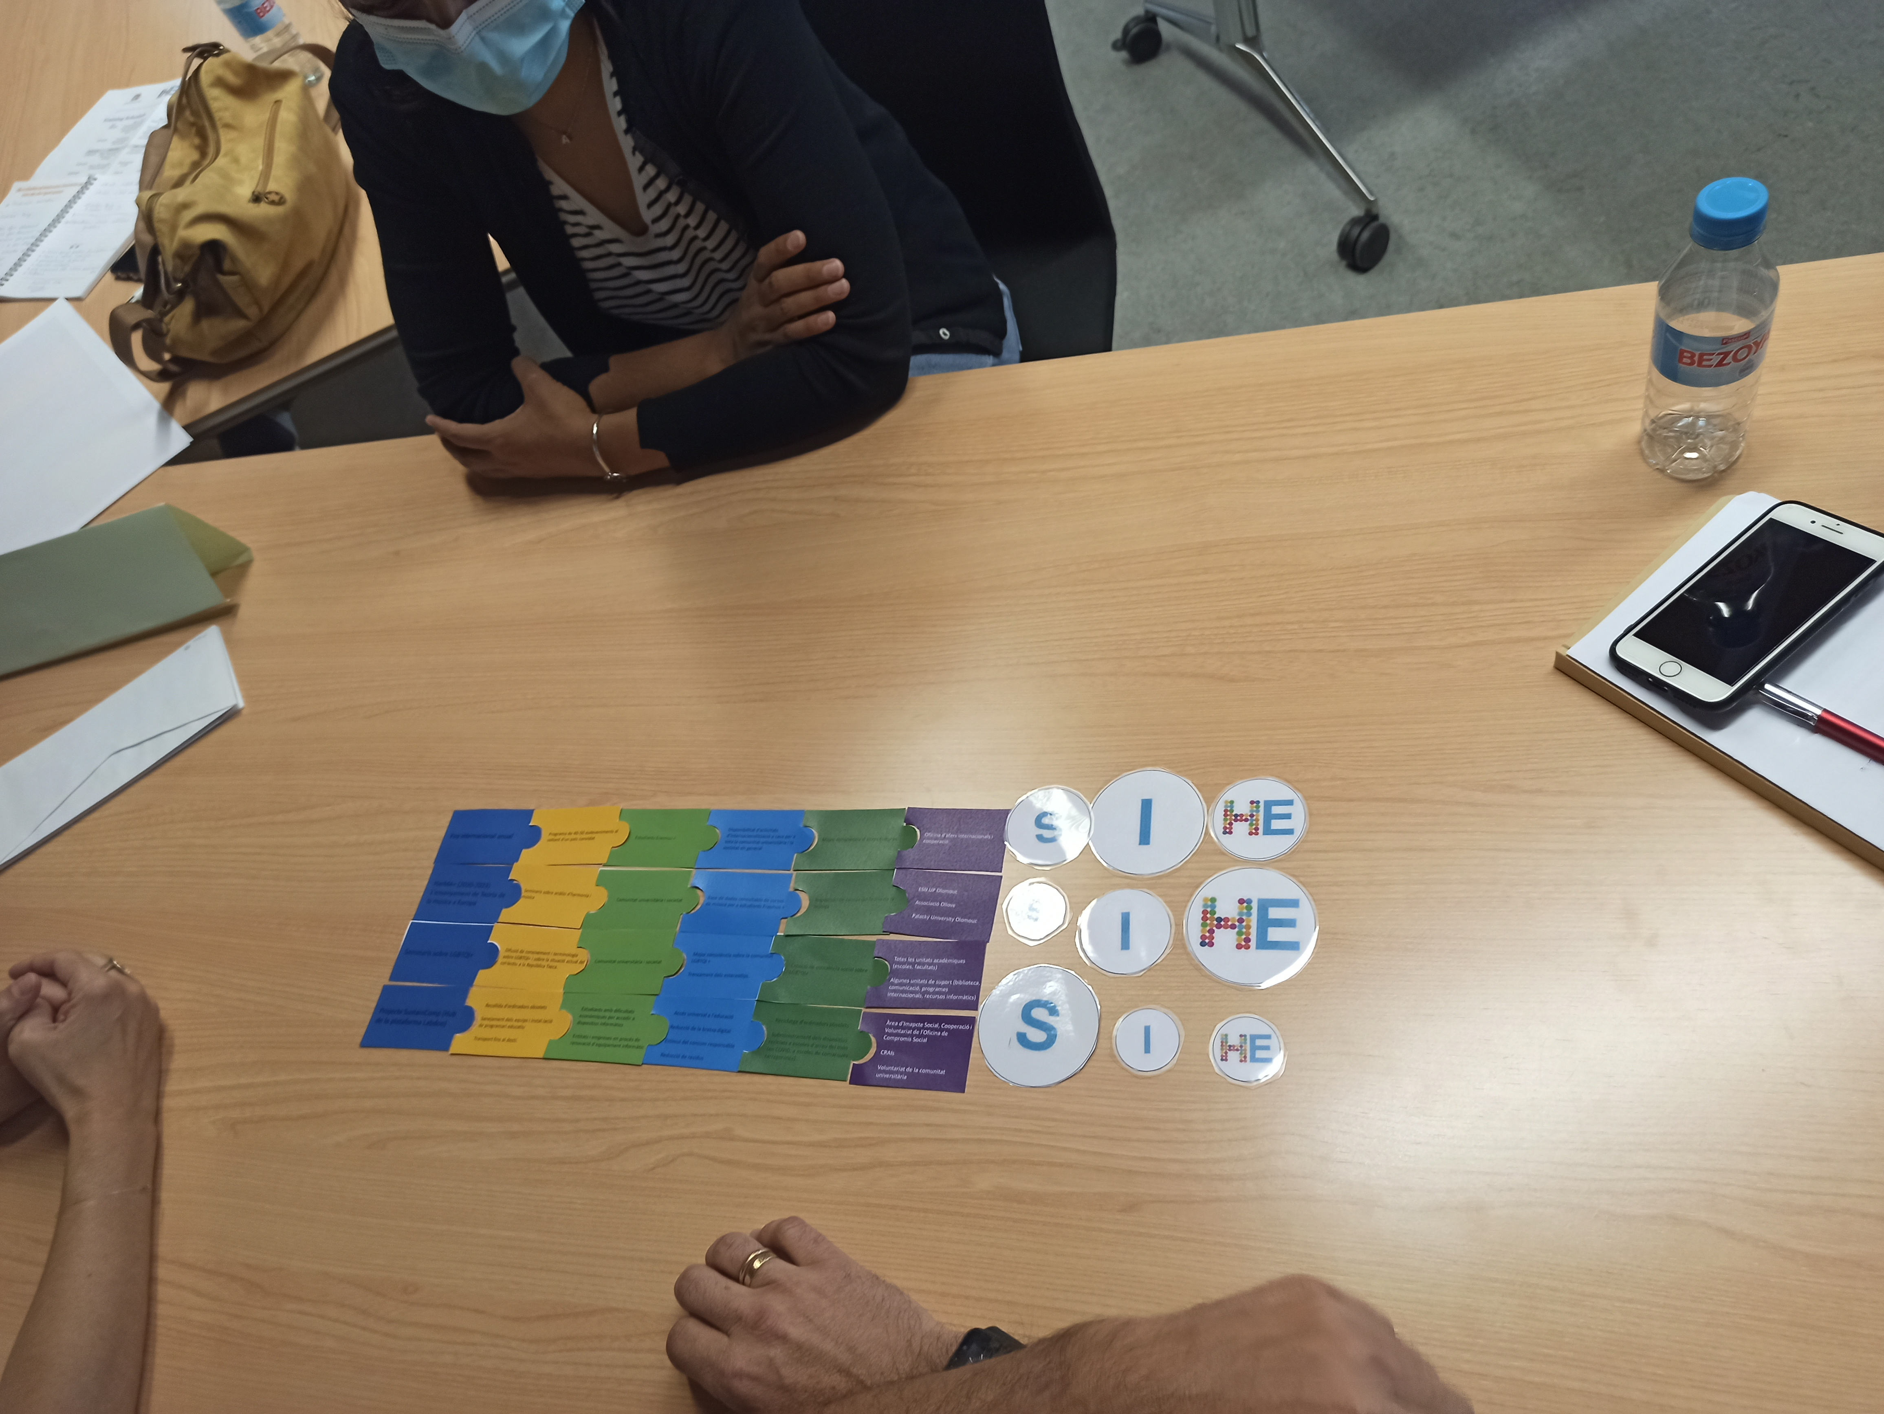
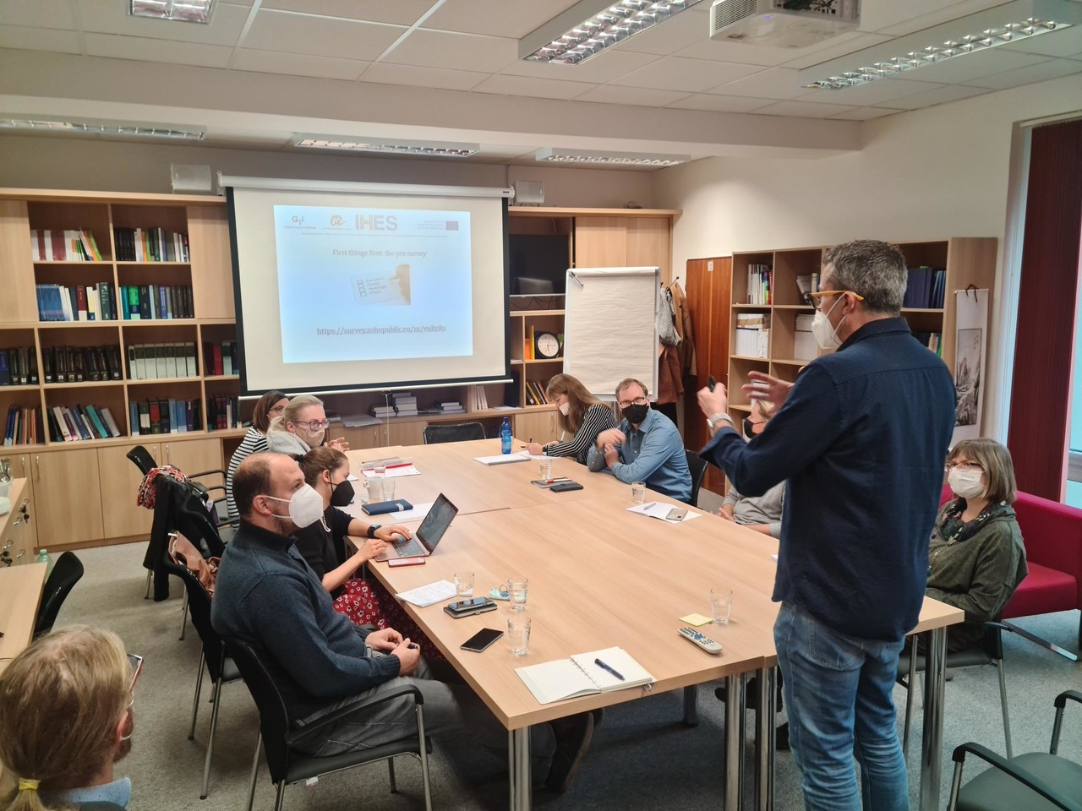
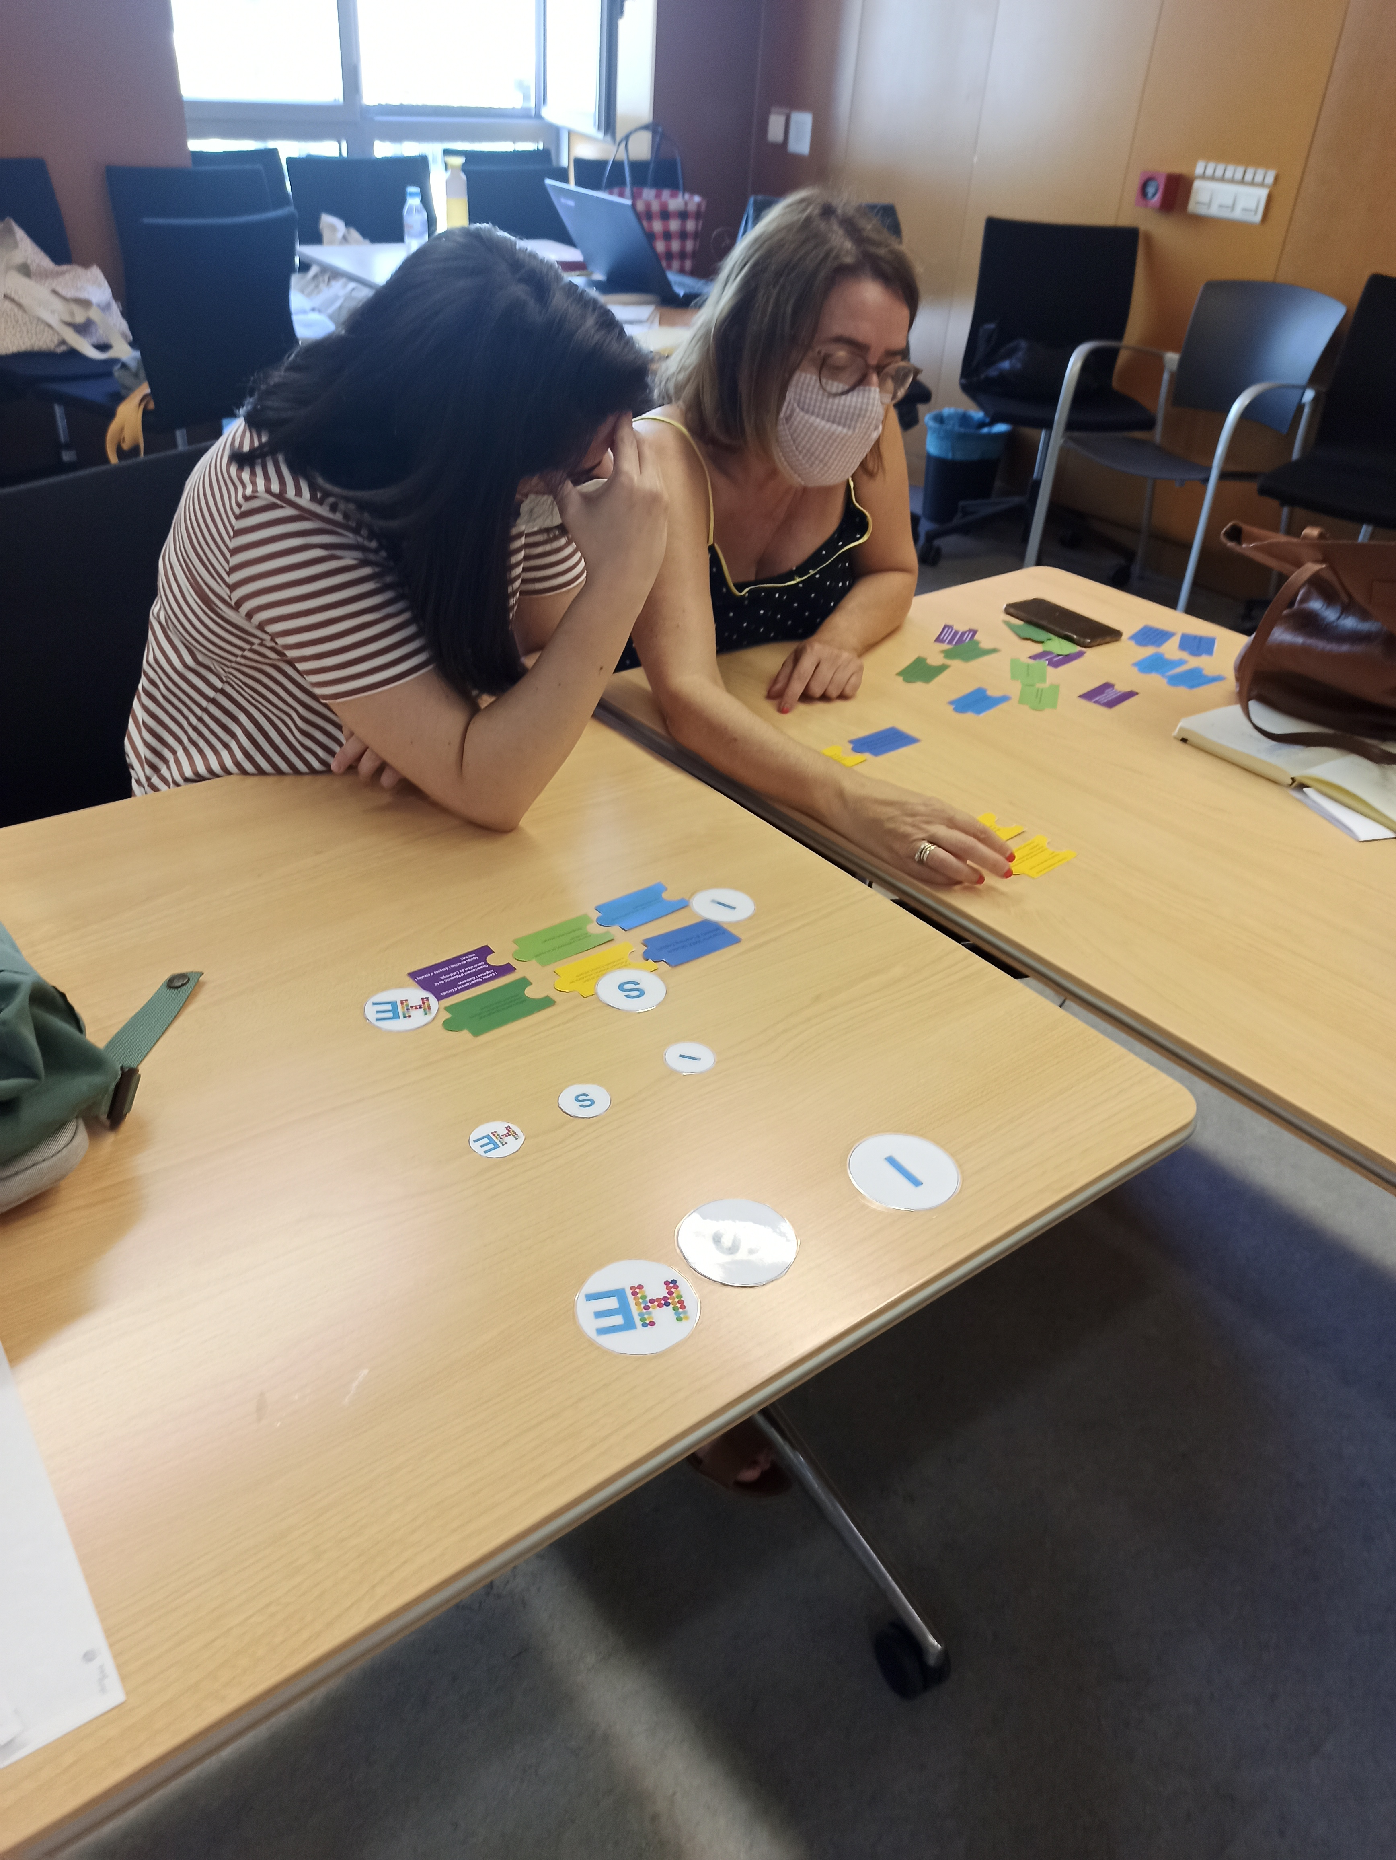
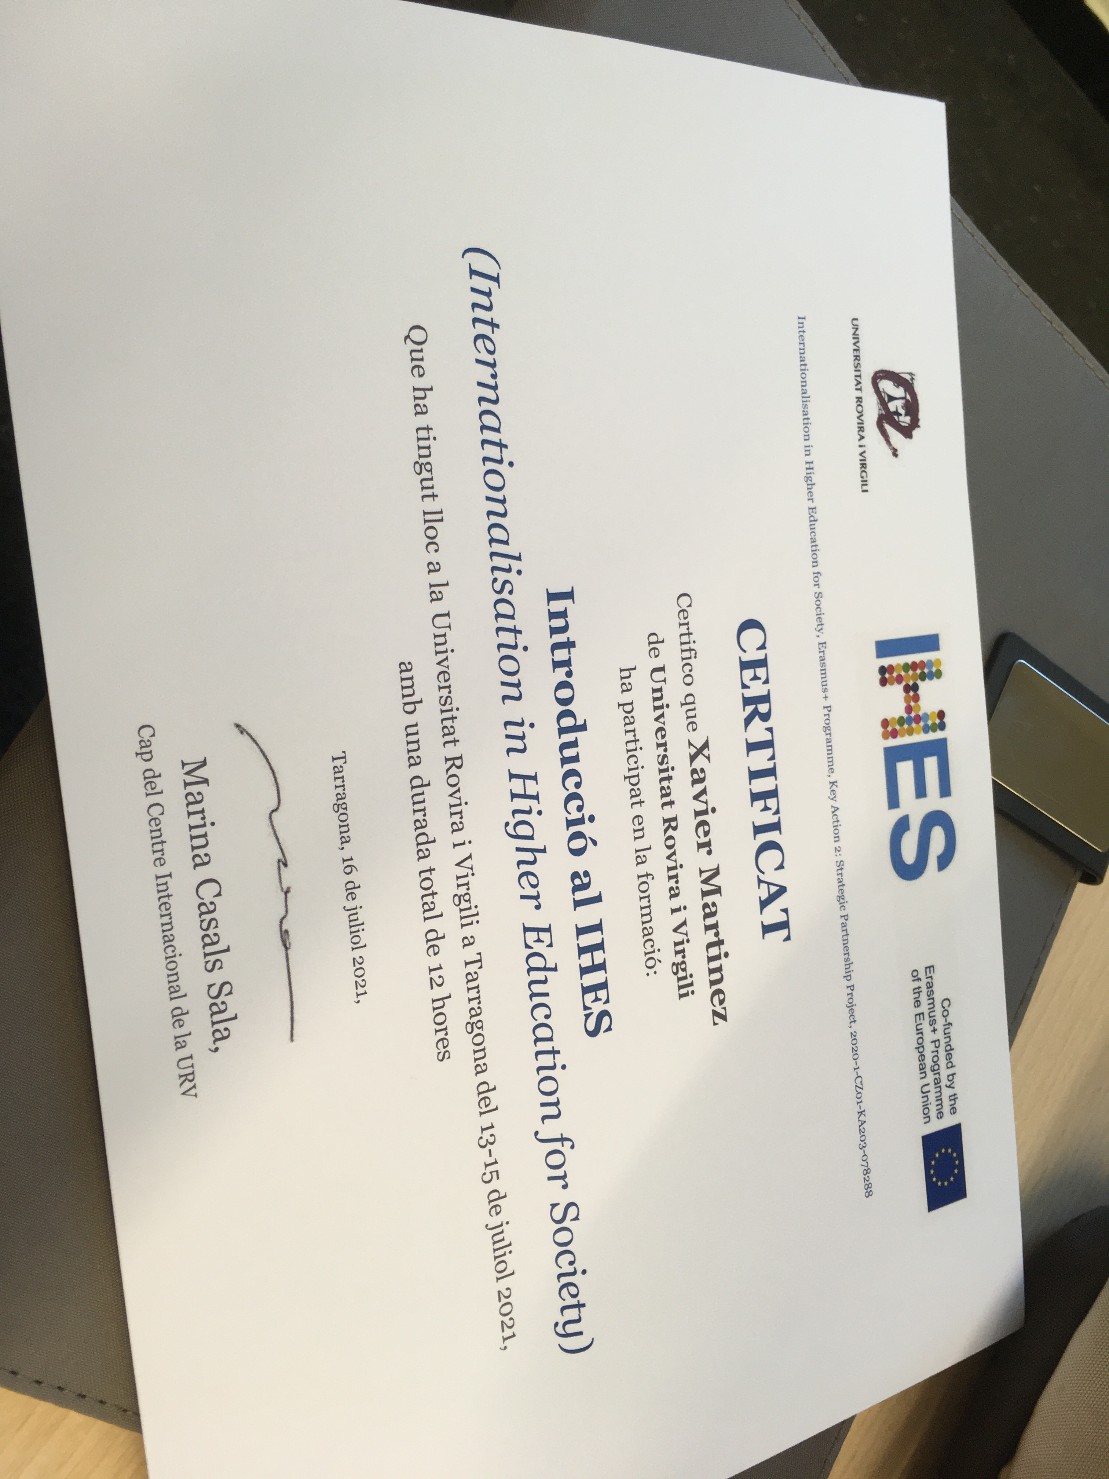
B3/ TRAINING TAKES PLACE

Slide 14
C/ IMPLEMENTATION of IHES ACTIVITIES = IHES Labs (1/2)
1. Program for English and other foreign languages in schools:
Incoming Erasmus students can have a real-life teaching experience in regional schools, with an academic manager being responsible for selection, monitoring and evaluation.
2. Program of Erasmus experience in high schools:
Returning Erasmus students can share their experience abroad with pupils from local schools to open up their mind and cultural awareness.
3. Program for society at large:
Presentations, debates and workshops on different aspects of multi-culturalism, led by our international community, in different localities of the region.
4. University seniors program:
Presentations and talks on different aspects of multi-culturalism, led by our international community, to complement the lectures already scheduled throughout the academic year in both regions.

Slide 15
C/ IMPLEMENTATION of IHES ACTIVITIES = IHES Labs (2/2)
5. International Sustainability Program:
Presentations and workshops with an international perspective on sustainability, targeting society at large. Environment Volunteer Program that will include international and local students and staff, together with local environmental NGOs.
6. Solidarity program:
Involve international students and staff in actions like a Fair Trade Event, presentations about cooperation for development projects around the world, solidarity actions and volunteer programs with local NGOs.
7. Sports program:
Sports services can offer specific open activities to society at large, in which the participation of international students and staff will be encouraged
8. International Service Learning:
Both institutions count with established Service Learning Units and will try to place their students in a receiving NGO from the other region.

Slide 16
D/ REPORT AND ANALYSIS OF IMPACT
IO3 will be concluded with a written report, which will
conceptualise IHES,
portray the different activities implemented,
and analyse in-depth the impact of the two IHES Labs (Catalonia and Olomouc), as well as
include a comparative study of the results of both Labs.

